Slide 1
MEDIUM ACCESS PROTOCOLS

Slide 2
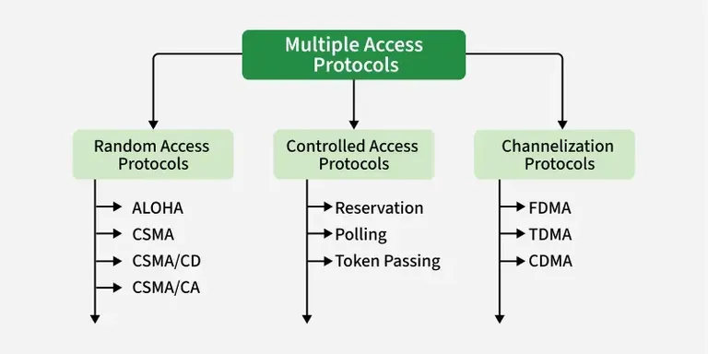

Slide 3
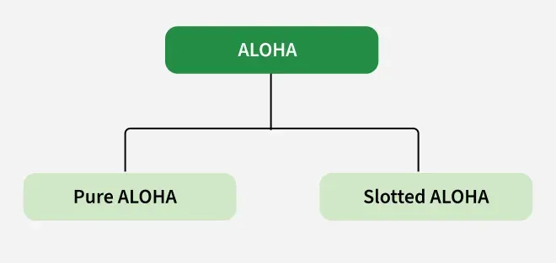
ALOHA
ALOHA is a random-access medium access control protocol used by multiple devices to share a single communication channel without central coordination.
Notes:
Designed for wireless LANs and shared media
Multiple stations can transmit simultaneously, leading to collisions

Slide 4
What is pure aloha?
ALOHA was the first MAC protocol developed for sharing a comm. Channel.
Designed to allow multiple users to communicate with a central computer over a shared comm channel.
Uses a single shared comm channel, where all users transmit their data (frames) to the central computer.
Can be applied to any comm. system where multiple uncoordinated users compete to use the same shared
Channel.

Slide 5
Pure aloha
Original version of the ALOHA protocol
Time is continuous; there are no fixed time slots for transmission.
A station can transmit a frame whenever it has data to send
If two or more stations transmit at the same time, a collision occurs, and the affected frames must be retransmitted
Simple to implement, but it experiences a higher number of collisions because transmissions can begin at any time.

Slide 6
How pure aloha works
Any station can transmit at any time
No carrier sensing
Collision detection
  If 2>= stations transmit at overlapping times → collision occurs
  The frames are corrupted and lost
  4. ACK
    Receiver sends an ACK if it successfully receives the frame
    Sender waits for ACK. If no ACK arrives within timeout → assume collision
    5. Retransmission ( S waits a random backoff time)
    Retransmit the same frame until successful or max attempts reached

Slide 7
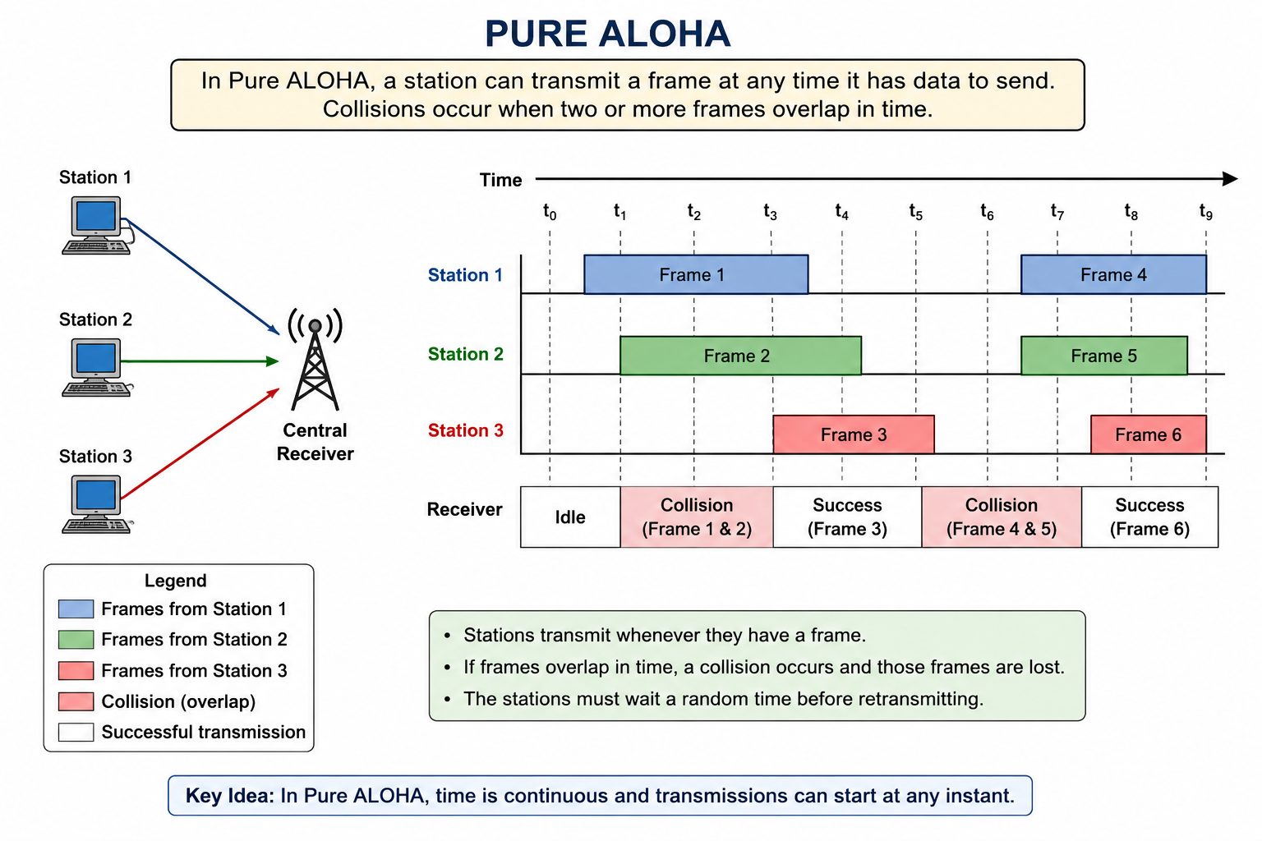

Slide 8
Disadvantages
High probability of collisions
  Stations can transmit at any time, making simultaneous transmissions likely
Low channel efficiency
  Many transmissions lost due to collisions, resulting to poor usage of the channel.
Frequent retransmissions
  Collided frames must be retransmitted, increasing network traffic
Notes:
Increased transmission delay
Poor performance under heavy traffic
Bandwidth wastage

Slide 9
Slotted aloha
Improved version of pure ALOHA
Time is divided into equal-sized slots, each slot is long enough to transmit one frame.
A station can only begin transmitting at the start of a time slot
If only one station transmits during a slot, the frame is transmitted successfully.
If two or more stations transmit in the same slot, a collision occurs, and the frames must be retransmitted

Slide 10
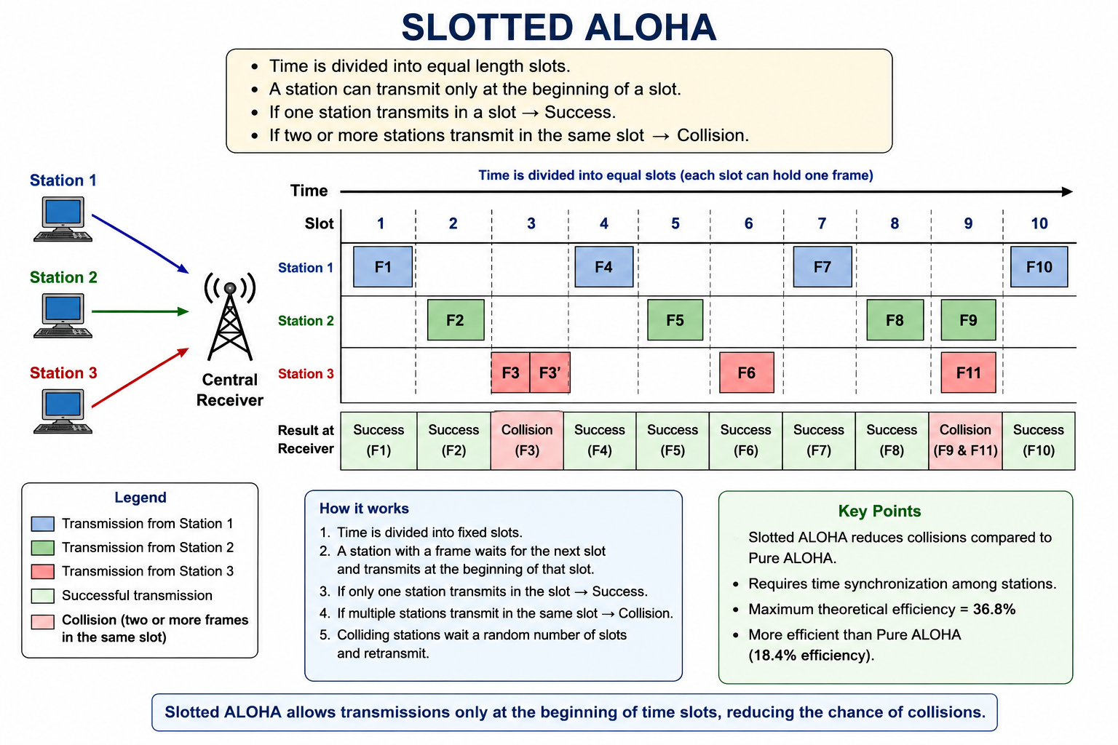

Slide 11
Advantages of slotted aloha
Reduces the number of collisions compared to pure ALOHA
Improves channel utilization
More efficient because transmissions are synchronized
Notes:
Both side must agree on when to send & receive data so they don’t get confused

Slide 12
Drawbacks of slotted aloha
Requires time synchronization
  All stations must agree on the start and end of each time slot.
Collisions can still occur
  If multiple stations transmit in the same slot, their frames collide.
Stations may have to wait
  A station with data to send must wait until the next slot begins.

